Slide 1
Fault Prediction and Software Aging
Carlos Perez

Slide 2
Outline
Software Lifecycle / Motivation
Software Aging / Problem
Fault Prediction / Approach
Methodology for Detection and Estimation of Software Aging
  Approach / Preventive Maintenance
  Experiment
  Data Analysis
  Results
  Conclusion

Slide 3
The Software Lifecycle
Youth
  Software is new, simple, efficient. Functionality might be limited.
Maturity
  As new requirements arise software becomes complex and code limitations surface.
Elderliness
  Aging has taken a heavy toll on performance.
Death
  Legacy App is replaced by newborn

Slide 4
DOS: A Case Study
Youth
  DOS - Simple, but very limited functionality
Maturity
  Windows 3.1 – GUI interface on top of DOS. More functionality, but more bugs
  Windows95/97 – More functionality, new bugs, performance has suffered.
Elderliness
  Windows98 – Many bugs have been patched, but increasing functionality is risky at this point.
Death
  Windows XP was introduced!

Slide 5
The Software Aging Problem
The main problem with legacy code is aging
What is Software Aging?
  Deterioration in the availability of OS resources, data corruption and numerical error accumulation
Consequences
  Performance degradation
  Crash / Hang
  Failure

Slide 6
Causes of Software Aging
Common causes of software aging are:
  Memory bloating or leaks
  Unreleased file-locks
  Data corruption
  Storage space fragmentation
  Accumulation of round off errors
Legacy code is more likely to experience these kind of problems

Slide 7
Combating Software Aging
Research Question: How can we combat software aging?
Why is it a challenging problem?
  It is caused by heisenbugs (hard to find bugs)
  It is an inherent characteristic of elderly systems
  It is hard to detect
  It can be present in critical systems

Slide 8
Software Rejuvenation Approach
Software rejuvenation is a proactive fault management technique aimed at cleaning up the system internal state to prevent the occurrence of future failures.
Examples of cleaning:
  Garbage collection
  Kernel table flushing
  Rebooting
Advantages:
  Prevents crashes from occurring
  Provides fault tolerance in the presence of bugs
Disadvantages:
  Introduces overhead

Slide 9
Fault Prediction
Fault prediction tries to detect errors before they happen
  It monitors system resources in order to detect and estimate aging
  It computes an “estimated time to failure”
Preventive measures can be taken to avoid crashes
  Enables software rejuvenation

Slide 10
S. Garg et al. “A methodology for detection and estimation of software aging.” In Proc. 9th International Symposium on Software Reliability Engineering, 1998
Presents a methodology for fault prediction based on the characterization of software aging

Slide 11
Approach
Collect UNIX system resource usage at regular intervals using a distributed monitoring tool
Use statistical trend detection techniques to detect and validate the existence of aging in UNIX.

Slide 12
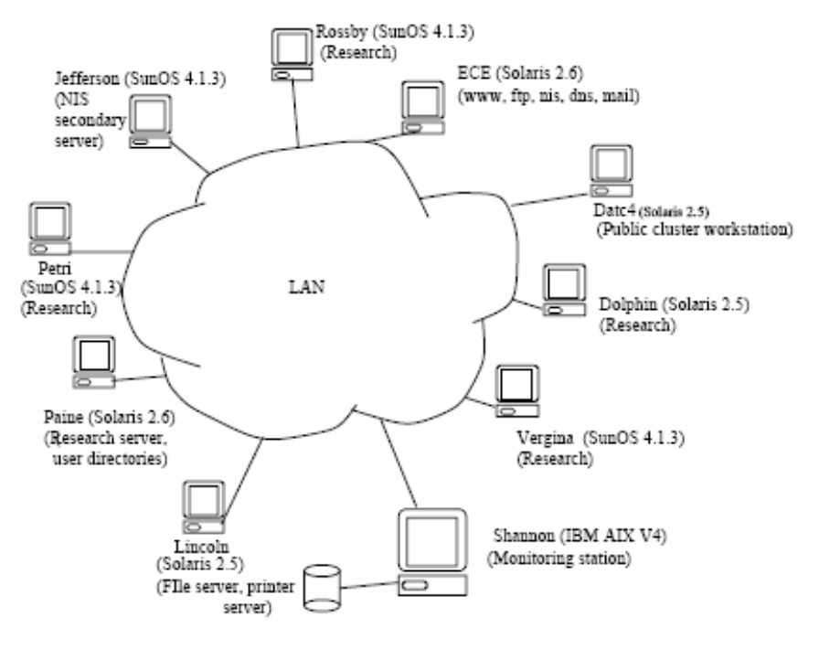
Experimental Setup
Distributed monitoring tool based on SNMP
  Works like a distributed database
  Monitors state of UNIX running in stations
Monitoring station
  Queries SNMP agent at each workstation
  Determines “health” of each system

Slide 13
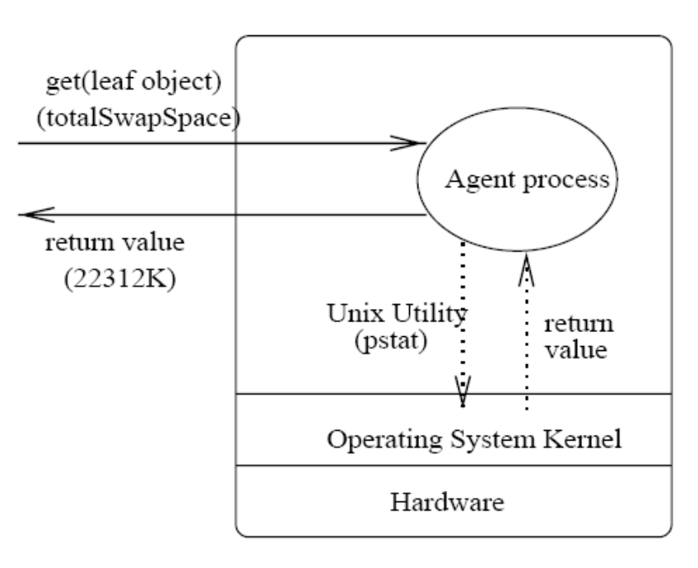
SNMP Model
SNMP – Simple Network Management Protocol
  Supports monitoring of network-attached devices
Pro-Active Fault Management MIB
  Defines a set of objects that can be queried on any workstation by the managing station
  These objects describe the state of the workstation

Slide 14
PFM MIBs
hostID – provides basic information about the station
timeVal – provides current time and time since last reboot
osResource – describes state of OS resources such as free memory, file table size, etc.
procStats – describes state of processes running
etc, etc…

Slide 15
Data Collection
Heterogenous UNIX workstations were monitored
Their resource data was gathered every 15 minutes
Crashes are recorded for correlation purposes

Slide 16
Data Analysis
The data gathering face provides a time series for every object monitored
Using these time series several issues are addressed:
  Is aging present?
  What is the nature of the variations in the value?
  Can failures be related to observed values?
  Can we quantify aging?

Slide 17
Data Analysis
Visual cues
  Can periodicity be clearly seen from time series plots?
  Is an increasing/decreasing trend visible?
  What analysis should we do?
Classical time series analysis
  Linear and periodic dependency analysis
  Trend detection and estimation

Slide 18
Periodicity and Linear Dependence
Determines the nature variations in data
Approach
  Autocorrelation function
  Harmonic Analysis
Confirms daily and weekly periodicities in the data

Slide 19
Trend Detection and Estimation
Detection
  Trends indicate the presence of aging
  Approach looks for monotonically increasing/decreasing trends in resources
Estimation
  Trend estimation quantifies the aging
  Approach approximates slope of trend to estimate the expected time to resource exhaustion

Slide 20
Trend Detection
Smoothing
  Robust Locally Weighted Regression
  Reliable for nonlinear data
Test Trend Existence Hypothesis
  Seasonal Kendall Test
  Detects trends in the presence of cycles

Slide 21
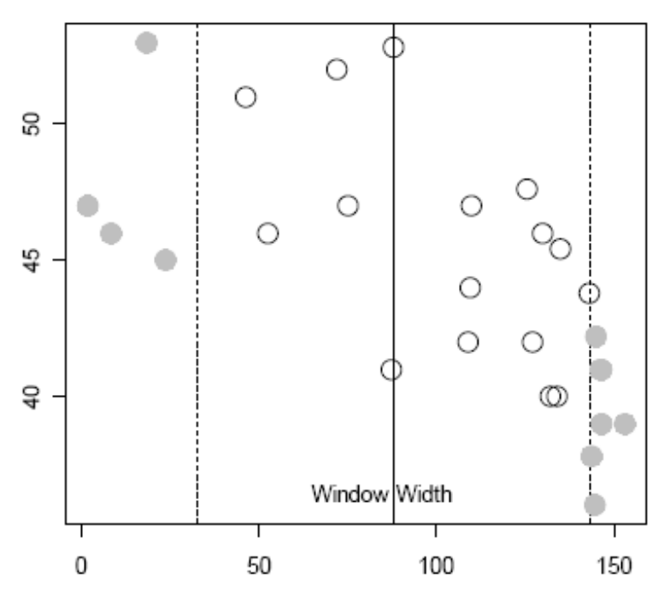
Smoothing Step 1
Start at focal point
Define the window width
  Larger size causes heavier smoothing
  Overall trend is captured

Slide 22
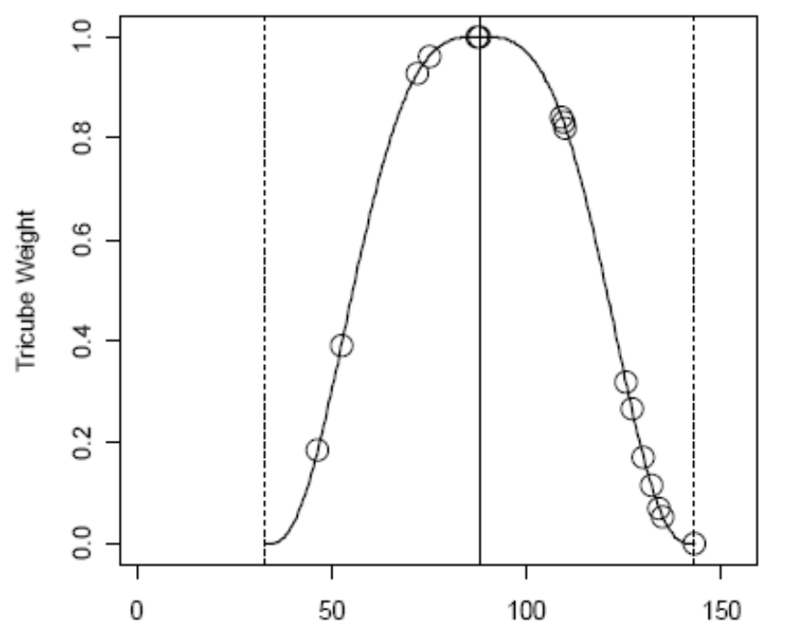
Smoothing Step 2
Choose a weight function
  Tricube weight function is the most common

Slide 23
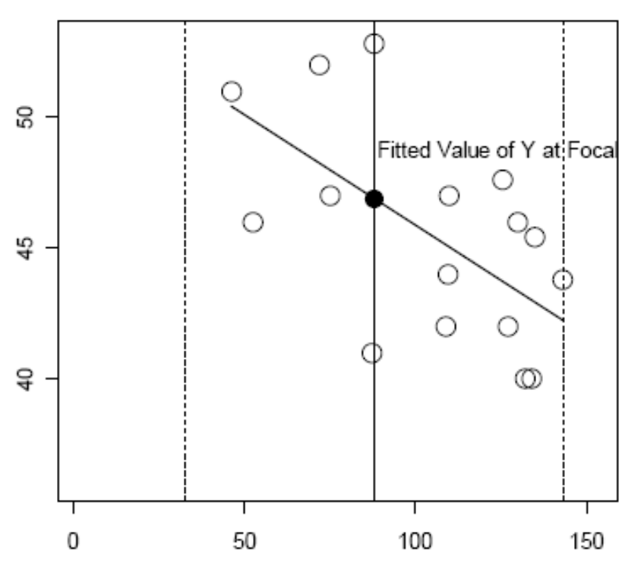
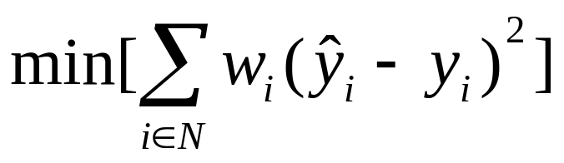
Smoothing Step 3
Polynomial regression using weighted least squares
Take fitted value at focal point from regression
These steps are repeated at every X

Slide 24
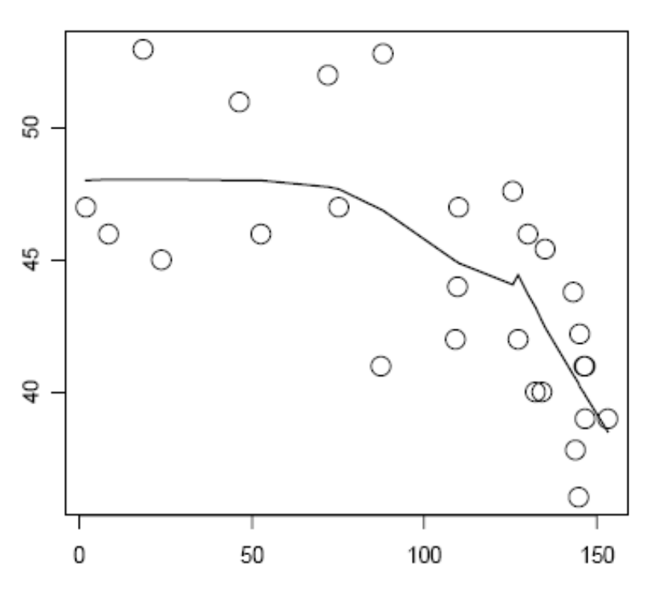
Smoothing Results
Steps are repeated for every observation in the data
A separate local regression is performed at each X
The fitted value for each focal X is plotted

Slide 25
Trend Hypothesis
Seasonal Kendall test
  Compares the relationships of points at different time periods (seasons)
  Determines if a trend exists

Slide 26
Trend Estimation
Once we confirm the existence of a trend, we must estimate its slope
Sen Slope
  Determines the slope at each point and takes the median of the slopes.

Slide 27
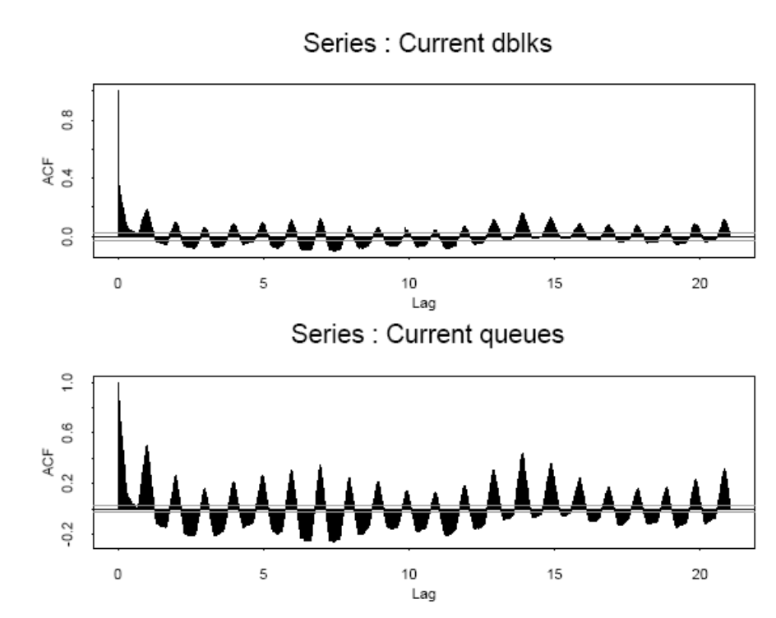
Results
Periodicities and Linear Dependence
  Many values show daily and weekly periodic dependencies

Slide 28
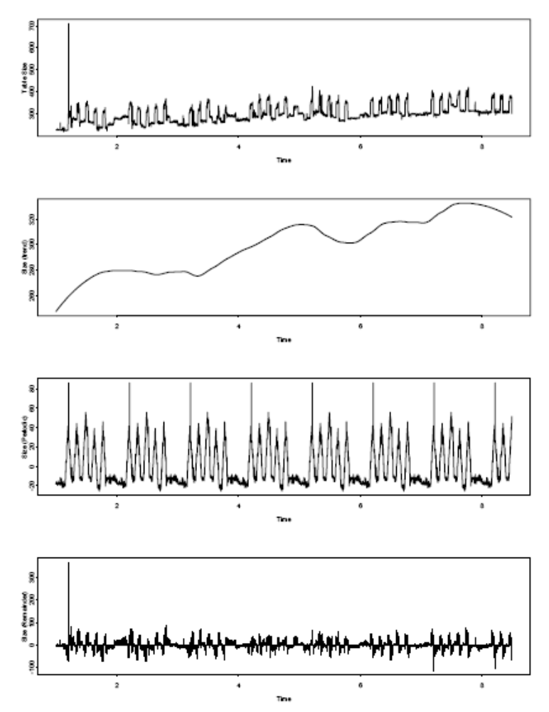
Results
Existence of aging
  Proved for file table size using seasonal trend decomposition
  Original time series
  Increasing trend from regression
  Periodicities
  Residual

Slide 29
Aging Quantification
Estimated time to failure due to aging is calculated with respect to a particular resource
Estimation is done from Sen’s slope and initial values
Important resources can then be identified for monitoring and managing

Slide 30
Conclusion
Quantification of software aging is presented as a means of fault prediction
Statistical analysis is an appropriate method for the detection and estimation of software aging
Can help in developing a strategy for software rejuvenation

